Slide 1
Productivity hacks for managers and their teams
Leverage International Toolboxes For Increased Performance (German-Ghanaian Case Study)
BENJAMIN SCHUNKE KWAME OSEI-TUTU

Slide 2
Our company FAIRPOINTERS – we are all about PRODUCTIVITY
FAIRPOINTERS as a Company...
... and as a Service Provider
Our purpose is to create scalable and quality employment in Africa.
We upskill & manage our staff to international standards.
Linking outstanding minded talents with ambitious and demanding clients overseas.
We achieve this by:
Relentless productivity orientation, using best practice tools
Unconditional client orientation
True mental health management
Tailored training for team excellence
Our mission is to make our clients more productive – by doing their work for them
We specialize in creating high-quality presentations & documents for C-level and international consultants
We work overnight as well as ad-hoc
We handle a wide range of tasks, including:
Sketches to presentation
Presentation story lining
Data analysis & visualization
Tailored business illustrations​

Slide 3
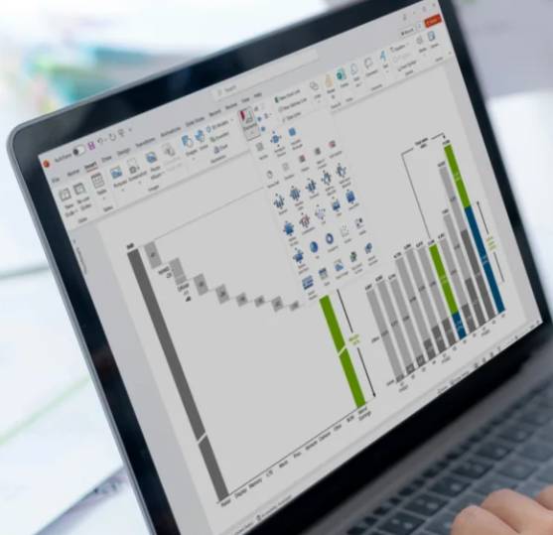
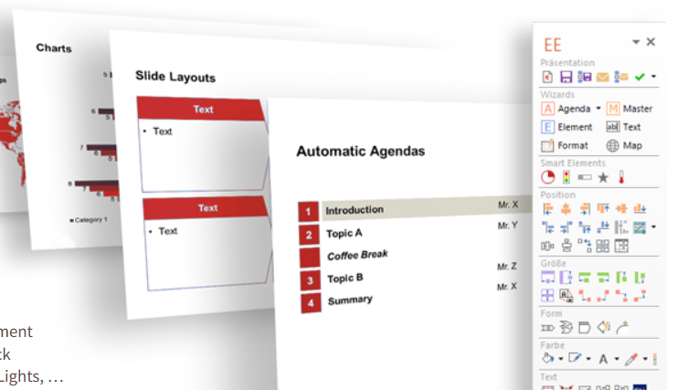
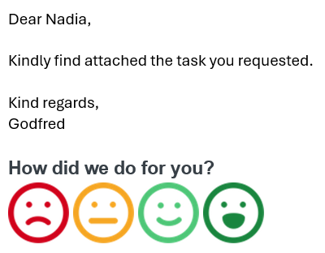
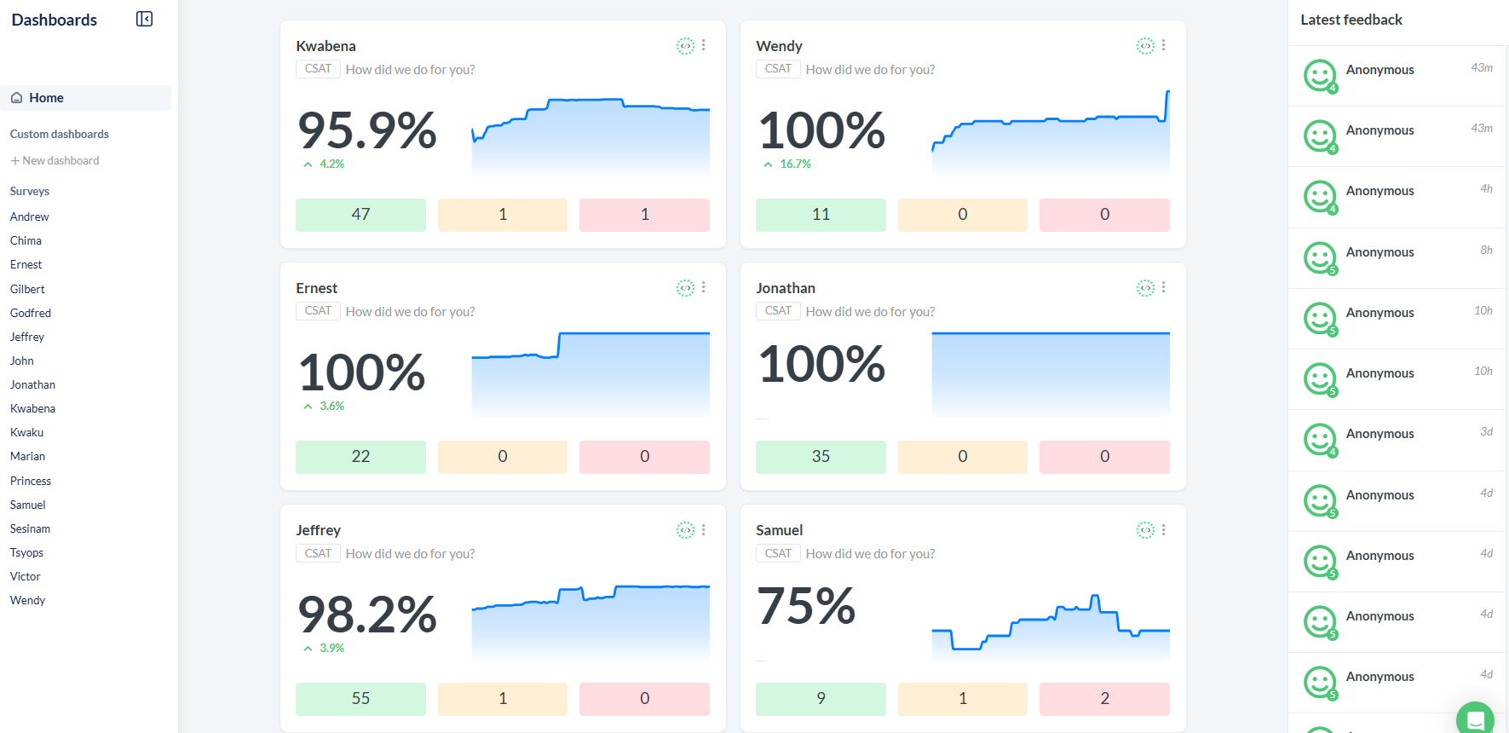
OUR PRODUCTIVITY TOOL BOX (1/2)
Tool 1
THINKCELL
Add-on for PPT & XLS
Saving us up to 70% time to create tailored and adaptable data visualization
Tool 2
EFFICIENT ELEMENTS
Add-on for PPT
SAVING US UP TO 80% to create concise and structured presentations & DOCUMENTS
Tool 3
SIMPLESAT
Web-based client satisfaction
QUADRUPLED OUR CLIENT feedback, true insights into staff performance

Slide 4
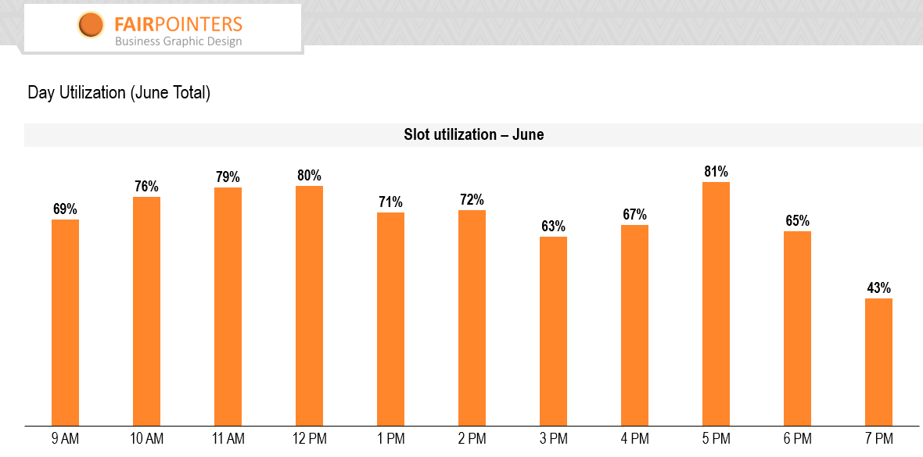
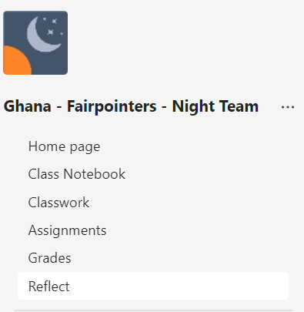
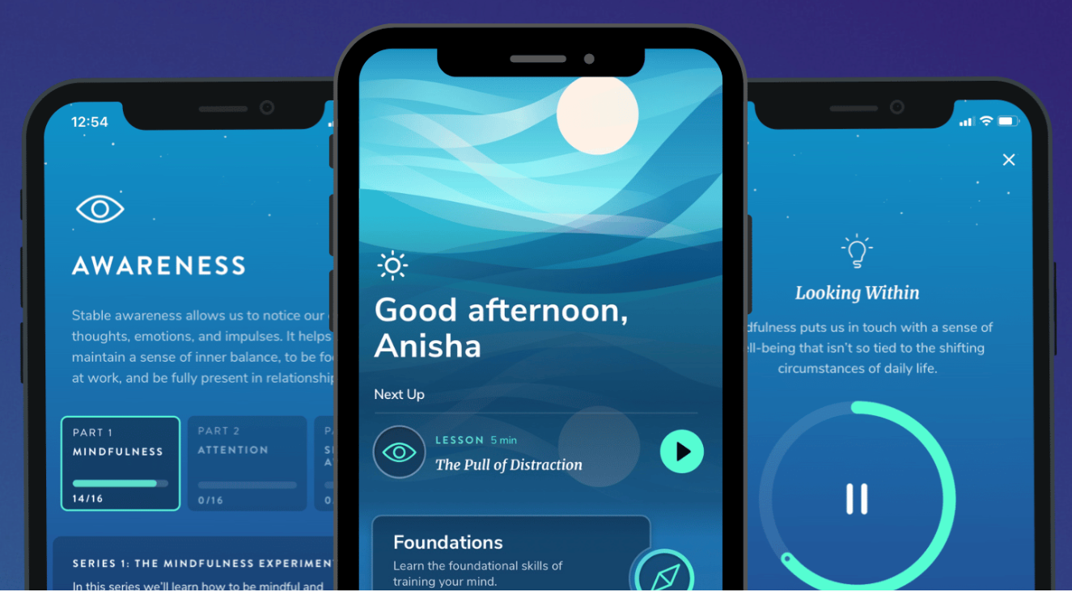
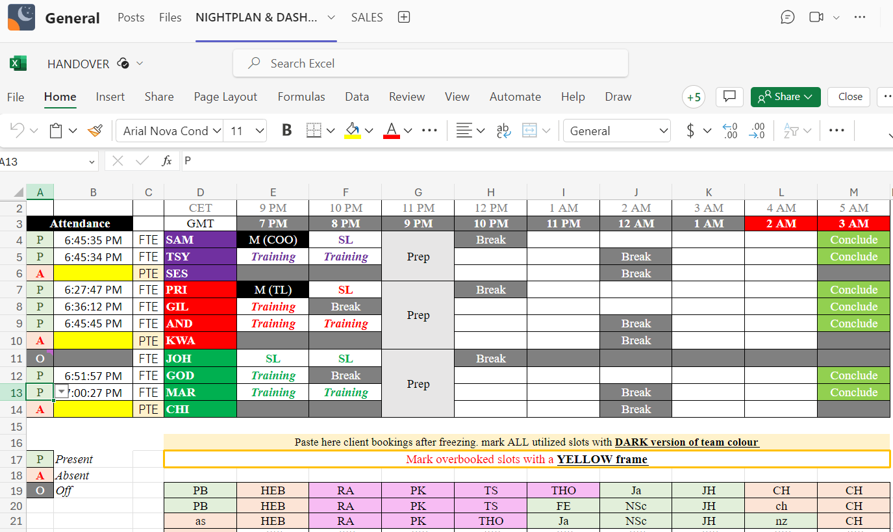
OUR PRODUCTIVITY TOOL BOX (2/2)
Tool 4
MS TEAMS FOR EDU
Education version of MS Teams
PUTS TEAM IN A LEARNING ENVIRONMENT, training assignments, feedback etc
Tool 5
CAPACITY PLANNER
Internal XLS
tracking of output & ALLOCATION OF TASKS on hourly basis for all staff – 100% transparency
Tool 6
HEALHTY MINDS
App-based
GUIDED PATH FOR ALL STAFF FOR MORE RESLIENCE AND STRESS MANAGEMENT – FREE & SCIENCE BASED! Enabled by user group and mental health coach

Slide 5
DEEP DIVE 1: CLIENT FEEDBACK as source for productivity
Real-time monitoring & alerts
Deep-dives on staff level
Trend analysis
CSAT results in renumeration

Slide 6
DEEP DIVE 1: CLIENT FEEDBACK as source for productivity (cont’d)
Positive Feedback
Negative Feedback
Positive feedback serves as a morale booster for our team.
We perform a thorough analysis of the feedback to identify the underlying causes of the issues raised.
By reviewing feedback, we can find and record what works best for our clients (i.e. being more productive)
We integrate feedback into our quality assurance processes to ensure continuous improvement.
Provides validation for new ideas and innovative approaches that have been successfully implemented.
We can upskill our team in areas identified by clients, to meet client expectations and avoid similar issues in the future.
Triggers monthly and quarterly staff bonus (renumeration), considered for promotions

Slide 7
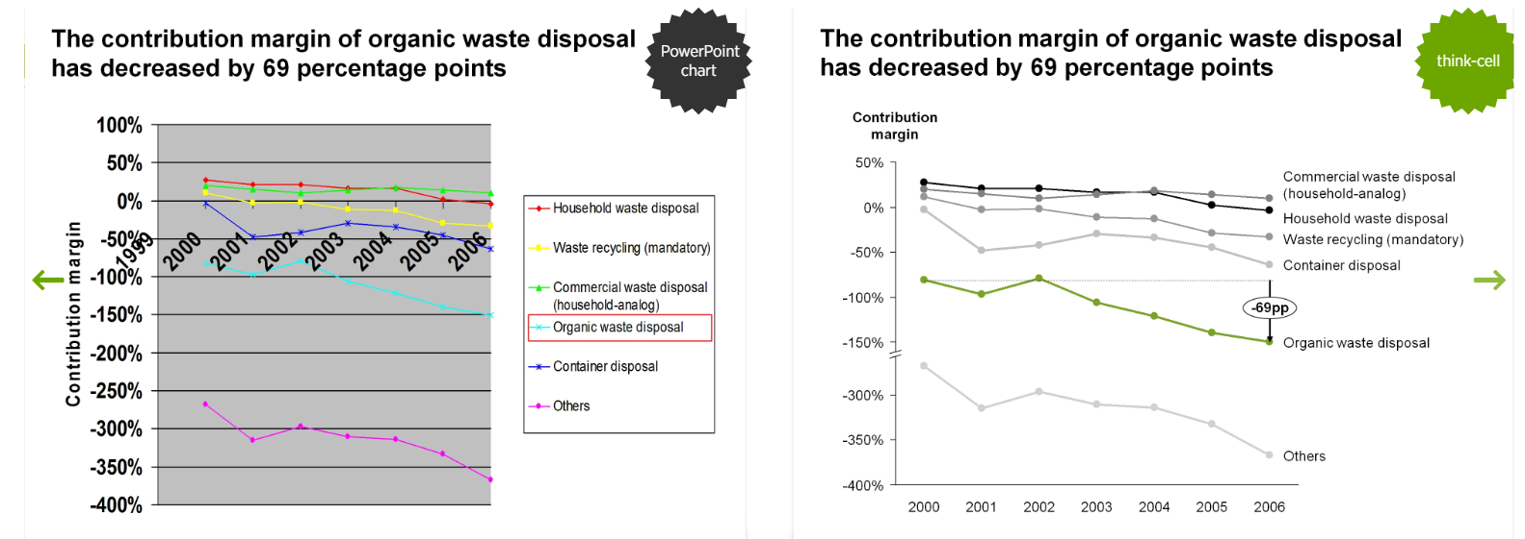
DEEP DIVE 2: THINKCELL as productivity booster
89%
OF THE TOP 100 US BLUE CHIP COMPANIES USE THINKCELL, A CHARTING AND LAYOUT AUTOMATION TOOL – BOOSTING EFFICENCY AND QUALITY. IT MAKES STAFF MORE PRODUCTIVE, BUT MOREOVER IT ALLOWS MANAGERS TO UNDERSTAND FINALLY THE DATA OUTPUT OF THEIR TEAMS.
Financial & data charts can be painful. Often, staff does not use automation. Usually, the teams start to manually update numbers and pushing around shapes, creating faulty and confusing outputs. It takes forever and does not fulfill reporting requirements of managers.

Slide 8
DEEP DIVE 3: LISTEN TO THE TEAM
COLLECTING, FILTERING, CHALLENGING and IMPLEMENTING TEAM FEEDBACK IS HARD, but worth the work
SOME OF OUR BEST INNOVATIONS started with staff feedback!

Slide 9
Thank you
BENJAMIN SCHUNKE & KWAME OSEI-TUTU
Co-FOUNDers FAIRPOINTERS – AZUBI AFRICA
benjamin.schunke@azubiafrica.org
kwame.osei-tutu@azubiafrica.org

